Slide 1
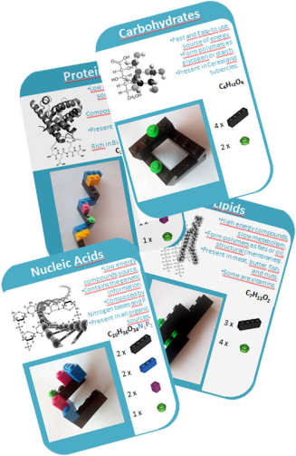
LIFE BRICKS 2.1
Cards
THE FOLLOWING SLIDES HAVE TO BE PRINT DOUBLE-SIDED, CUT AND PLASTICIZED
This card is part of the materials of the activity “LifeBricks” Materials of the activity and Didactic Guides are available for its download at: https://bit.ly/2ZksPOp

Slide 2
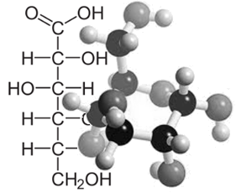
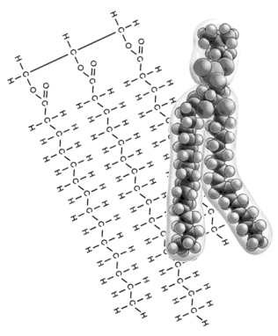
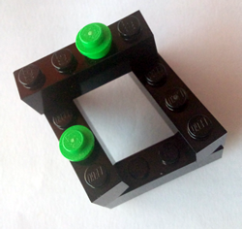
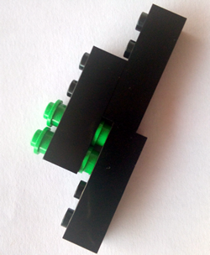

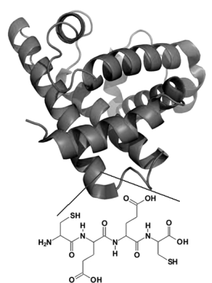
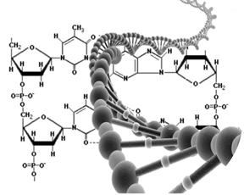
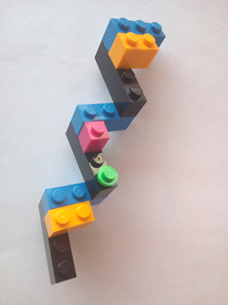
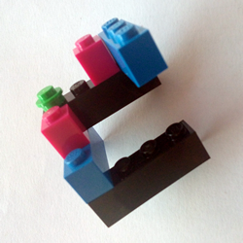



Carbohydrates
Lipids
Fast and Easy-to use source of energy.
Form polymers as glycogen or starch.
Present in Cereal and tubercles.
High energy compounds, slow metabolism.
Form polymers as fats or oil, structural (membranes).
Present in meat, butter, fish, and nuts.
Some are vitamins.
C₆H₁₂O₆
C₇H₁₃O₂
4 x
3 x
2 x
4 x
Proteins
Nucleic Acids
Low energy compounds source, structural and signaling funtions.
Composed by amino acids, forming peptides.
Present in meat, fish, eggs and vegetables.
Rich in Bioelements (P,S,...)
Low energy compounds source.
Contains the genetic information.
Composed by Nitrogen bases and P.
Present in all organic sources.
C₂₀H₄₂O₃₂N₂P₁S₁
C₂₀H₃₆O₃₄N₁P₂
3 x
2 x
3 x
2 x
2 x
2 x
1 x
1 x
1 x

Slide 3
LIFE BRICKS
LIFE BRICKS
This card is part of the materials of the activity “LifeBricks” designed by Jordi Domènech.
Materials of the activity and Didactic Guides are available for its download at:
https://bit.ly/2ZksPOp
These materials are shared under a Creative Commons License by-nc-sa 4.0.
You are free to Share and Adapt under the following terms: Attribution, Non Commercial Uses, Share Alike. Images from Lego pieces are excluded from this general License.
This card is part of the materials of the activity “LifeBricks” designed by Jordi Domènech.
Materials of the activity and Didactic Guides are available for its download at:
https://bit.ly/2ZksPOp
These materials are shared under a Creative Commons License by-nc-sa 4.0.
You are free to Share and Adapt under the following terms: Attribution, Non Commercial Uses, Share Alike. Images from Lego pieces are excluded from this general License.
LIFE BRICKS
LIFE BRICKS
This card is part of the materials of the activity “LifeBricks” designed by Jordi Domènech.
Materials of the activity and Didactic Guides are available for its download at:
https://bit.ly/2ZksPOp
These materials are shared under a Creative Commons License by-nc-sa 4.0.
You are free to Share and Adapt under the following terms: Attribution, Non Commercial Uses, Share Alike. Images from Lego pieces are excluded from this general License.
This card is part of the materials of the activity “LifeBricks” designed by Jordi Domènech.
Materials of the activity and Didactic Guides are available for its download at:
https://bit.ly/2ZksPOp
These materials are shared under a Creative Commons License by-nc-sa 4.0.
You are free to Share and Adapt under the following terms: Attribution, Non Commercial Uses, Share Alike. Images from Lego pieces are excluded from this general License.

Slide 4
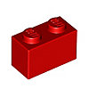

Inventory
This box contains the following materials:
39 x
Organic Carbon Chain
15 x
Nitrogen Group
6 x
Sulphide Group
24 x
Oxygen
9 x
Phosphate Group
30 x
Hidrogen
24 x
Energy / Reductive
Power (ATP / NADPH)

Slide 5
LIFE BRICKS
This card is part of the materials of the activity “LifeBricks” designed by Jordi Domènech.
Materials of the activity and Didactic Guides are available for its download at:
https://bit.ly/2ZksPOp
These materials are shared under a Creative Commons License by-nc-sa 4.0.
You are free to Share and Adapt under the following terms: Attribution, Non Commercial Uses, Share Alike. Images from Lego pieces are excluded from this general License.

Slide 6
Team
1
2
Team
Inventory Tracking
Inventory Tracking
Lacking Pieces | Date
 | / /
 | / /
 | / /
 | / /
 | / /
 | / /
Lacking Pieces | Date
 | / /
 | / /
 | / /
 | / /
 | / /
 | / /
Team
3
Team
4
Inventory Tracking
Inventory Tracking
Lacking Pieces | Date
 | / /
 | / /
 | / /
 | / /
 | / /
 | / /
Lacking Pieces | Date
 | / /
 | / /
 | / /
 | / /
 | / /
 | / /

Slide 7
LIFE BRICKS
LIFE BRICKS
This card is part of the materials of the activity “LifeBricks” designed by Jordi Domènech.
Materials of the activity and Didactic Guides are available for its download at:
https://bit.ly/2ZksPOp
These materials are shared under a Creative Commons License by-nc-sa 4.0.
You are free to Share and Adapt under the following terms: Attribution, Non Commercial Uses, Share Alike. Images from Lego pieces are excluded from this general License.
This card is part of the materials of the activity “LifeBricks” designed by Jordi Domènech.
Materials of the activity and Didactic Guides are available for its download at:
https://bit.ly/2ZksPOp
These materials are shared under a Creative Commons License by-nc-sa 4.0.
You are free to Share and Adapt under the following terms: Attribution, Non Commercial Uses, Share Alike. Images from Lego pieces are excluded from this general License.
LIFE BRICKS
LIFE BRICKS
This card is part of the materials of the activity “LifeBricks” designed by Jordi Domènech.
Materials of the activity and Didactic Guides are available for its download at:
https://bit.ly/2ZksPOp
These materials are shared under a Creative Commons License by-nc-sa 4.0.
You are free to Share and Adapt under the following terms: Attribution, Non Commercial Uses, Share Alike. Images from Lego pieces are excluded from this general License.
This card is part of the materials of the activity “LifeBricks” designed by Jordi Domènech.
Materials of the activity and Didactic Guides are available for its download at:
https://bit.ly/2ZksPOp
These materials are shared under a Creative Commons License by-nc-sa 4.0.
You are free to Share and Adapt under the following terms: Attribution, Non Commercial Uses, Share Alike. Images from Lego pieces are excluded from this general License.

Slide 8
Team
5
6
Team
Inventory Tracking
Inventory Tracking
Lacking Pieces | Date
 | / /
 | / /
 | / /
 | / /
 | / /
 | / /
Lacking Pieces | Date
 | / /
 | / /
 | / /
 | / /
 | / /
 | / /
7
8
Team
Team
Inventory Tracking
Inventory Tracking
Lacking Pieces | Date
 | / /
 | / /
 | / /
 | / /
 | / /
 | / /
Lacking Pieces | Date
 | / /
 | / /
 | / /
 | / /
 | / /
 | / /

Slide 9
LIFE BRICKS
LIFE BRICKS
This card is part of the materials of the activity “LifeBricks” designed by Jordi Domènech.
Materials of the activity and Didactic Guides are available for its download at:
https://bit.ly/2ZksPOp
These materials are shared under a Creative Commons License by-nc-sa 4.0.
You are free to Share and Adapt under the following terms: Attribution, Non Commercial Uses, Share Alike. Images from Lego pieces are excluded from this general License.
This card is part of the materials of the activity “LifeBricks” designed by Jordi Domènech.
Materials of the activity and Didactic Guides are available for its download at:
https://bit.ly/2ZksPOp
These materials are shared under a Creative Commons License by-nc-sa 4.0.
You are free to Share and Adapt under the following terms: Attribution, Non Commercial Uses, Share Alike. Images from Lego pieces are excluded from this general License.
LIFE BRICKS
LIFE BRICKS
This card is part of the materials of the activity “LifeBricks” designed by Jordi Domènech.
Materials of the activity and Didactic Guides are available for its download at:
https://bit.ly/2ZksPOp
These materials are shared under a Creative Commons License by-nc-sa 4.0.
You are free to Share and Adapt under the following terms: Attribution, Non Commercial Uses, Share Alike. Images from Lego pieces are excluded from this general License.
This card is part of the materials of the activity “LifeBricks” designed by Jordi Domènech.
Materials of the activity and Didactic Guides are available for its download at:
https://bit.ly/2ZksPOp
These materials are shared under a Creative Commons License by-nc-sa 4.0.
You are free to Share and Adapt under the following terms: Attribution, Non Commercial Uses, Share Alike. Images from Lego pieces are excluded from this general License.

Slide 10
Team
9
10
Team
Inventory Tracking
Inventory Tracking
Lacking Pieces | Date
 | / /
 | / /
 | / /
 | / /
 | / /
 | / /
Lacking Pieces | Date
 | / /
 | / /
 | / /
 | / /
 | / /
 | / /
Team
Team
Inventory Tracking
Inventory Tracking
Lacking Pieces | Date
 | / /
 | / /
 | / /
 | / /
 | / /
 | / /
Lacking Pieces | Date
 | / /
 | / /
 | / /
 | / /
 | / /
 | / /

Slide 11
LIFE BRICKS
LIFE BRICKS
This card is part of the materials of the activity “LifeBricks” designed by Jordi Domènech.
Materials of the activity and Didactic Guides are available for its download at:
https://bit.ly/2ZksPOp
These materials are shared under a Creative Commons License by-nc-sa 4.0.
You are free to Share and Adapt under the following terms: Attribution, Non Commercial Uses, Share Alike. Images from Lego pieces are excluded from this general License.
This card is part of the materials of the activity “LifeBricks” designed by Jordi Domènech.
Materials of the activity and Didactic Guides are available for its download at:
https://bit.ly/2ZksPOp
These materials are shared under a Creative Commons License by-nc-sa 4.0.
You are free to Share and Adapt under the following terms: Attribution, Non Commercial Uses, Share Alike. Images from Lego pieces are excluded from this general License.
LIFE BRICKS
LIFE BRICKS
This card is part of the materials of the activity “LifeBricks” designed by Jordi Domènech.
Materials of the activity and Didactic Guides are available for its download at:
https://bit.ly/2ZksPOp
These materials are shared under a Creative Commons License by-nc-sa 4.0.
You are free to Share and Adapt under the following terms: Attribution, Non Commercial Uses, Share Alike. Images from Lego pieces are excluded from this general License.
This card is part of the materials of the activity “LifeBricks” designed by Jordi Domènech.
Materials of the activity and Didactic Guides are available for its download at:
https://bit.ly/2ZksPOp
These materials are shared under a Creative Commons License by-nc-sa 4.0.
You are free to Share and Adapt under the following terms: Attribution, Non Commercial Uses, Share Alike. Images from Lego pieces are excluded from this general License.

